Slide 1
Robot Design Overview
Team: @Rising Stars
Team No : 66782
Lego League 2025
Theme: Unearthed
f
Notes:
Ria

Slide 2
Team Members
Name Age
Riona Panda 10
Zoey Jain 11
Shaivi Aggarwal 11
Saanvi Loomba 11
Saumya Loomba 11
Girisha Gupta 11
Riya Patil 12
Notes:
Saanvi

Slide 3
Mission Strategy
Took mission board print out and marked on those sheets to find missions and path required.
Tried missions with hand.
Tried individual missions first and then combined them to optimize runs and time.
Tried various combinations to maximize score.
Picked ones that can be completed in 2.5 minutes and gives maximum score.
Notes:
Saanvi

Slide 4
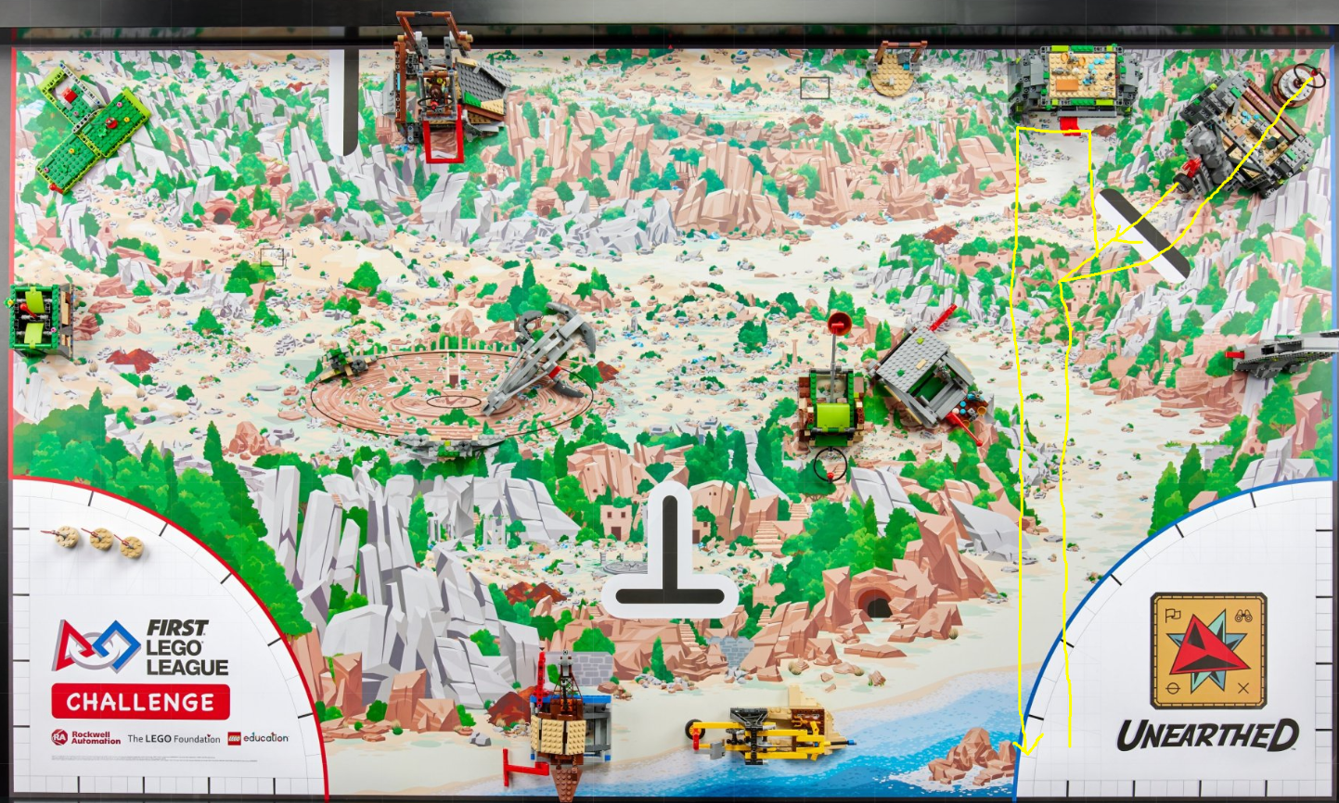
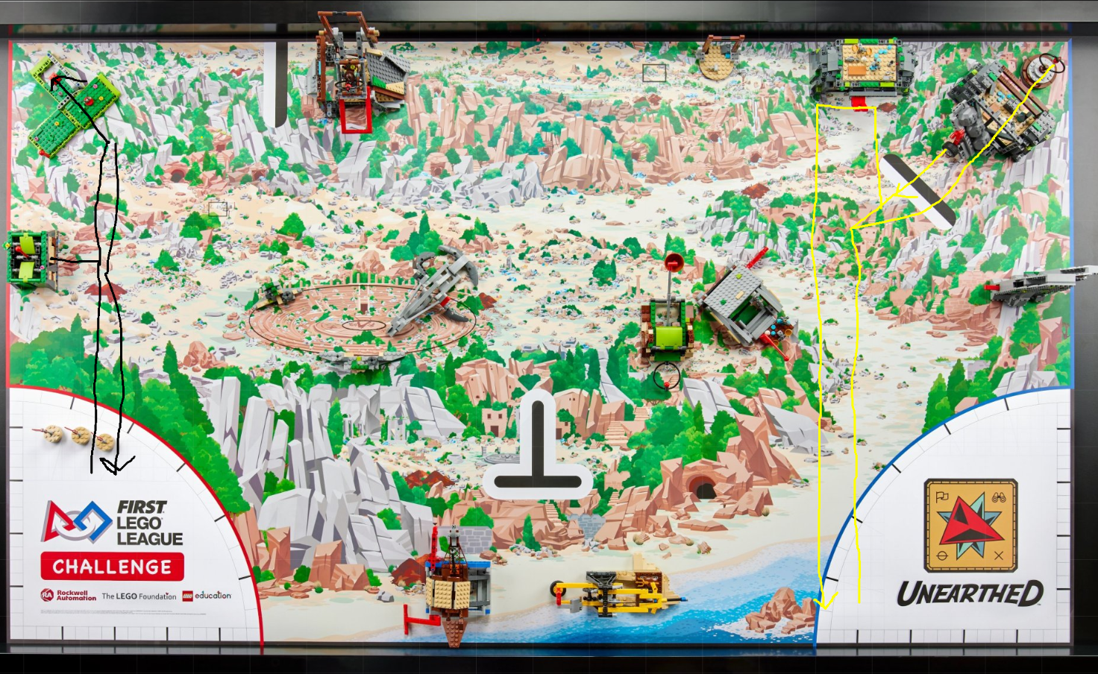
Mission Strategy
Notes:
Saanvi

Slide 5
Resources Used
Spike Prime Lessons
Online FLL Tutorials
Online research
Solon STEM scrimmage
Talked to other team coaches
Lego Studio 2.0
Lego robot design and team guides
Notes:
Zoey

Slide 6
Skill building
Did basic programs to move straight, turn, use sensors and motors
Created Pseudo code with paper and pencils
Shared and improved
Used gyro and color sensors to make our mission runs more reliable
Distributed work in two groups to get things done faster
Learned coding with Gyro to improve accuracy
Created reusable code blocks for different missions
Attended Solon STEM scrimmage and used learnings for improvement
Notes:
Shaivi

Slide 7
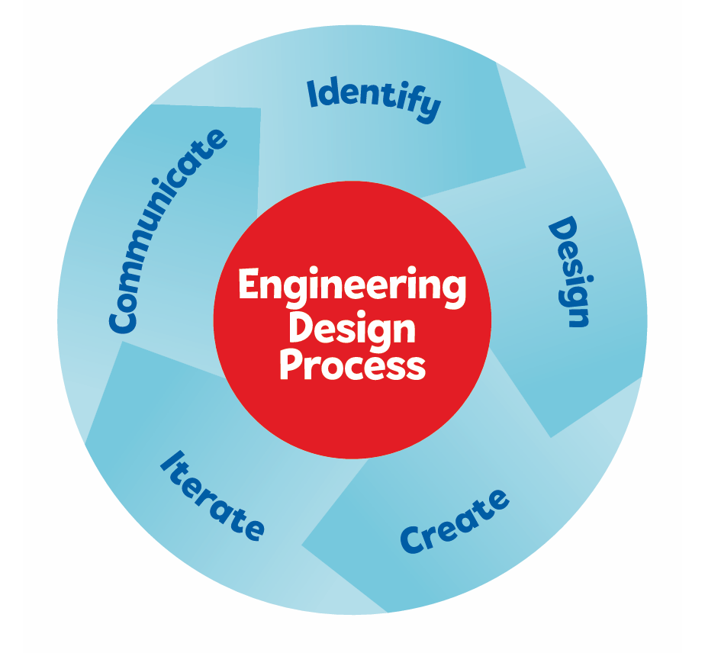
DESIGN- Robot Design
Reviewed mission board and various missions
Tried 3 different designs before picking final version.
Used Engineering Design Process to iterate and improve.
Combined learnings from last season and 3 earlier designs to design selected design.
Tried many runs to make small incremental improvements.
Notes:
Saumya

Slide 8
How we worked as a team
All 7 girls tried building and coding
We took turns and alternated between innovation project and robot building/coding
We rotated drivers, builders, and coders
Each person helped design at least one attachment or routine

Slide 9
What We Learned from Robot Design
Testing and changing small things can make a big difference
Using sensors makes the robot more reliable than only timers
Robot weight need to be evenly distributed
Working together and sharing ideas helped us solve harder missions

Slide 10
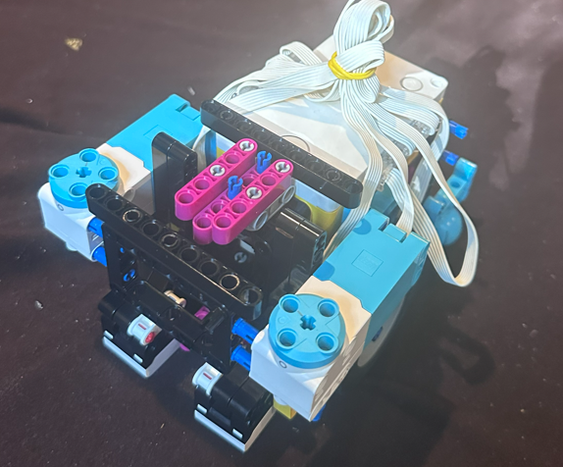
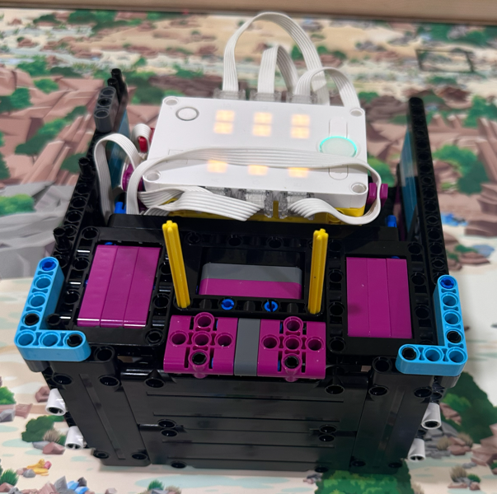

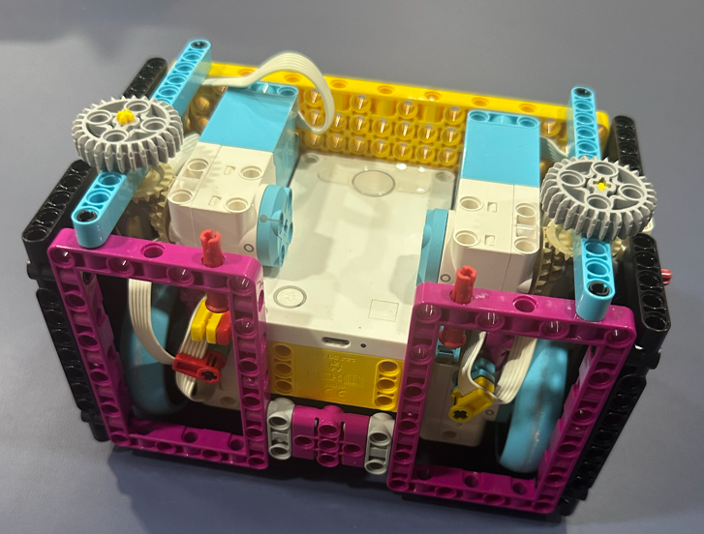
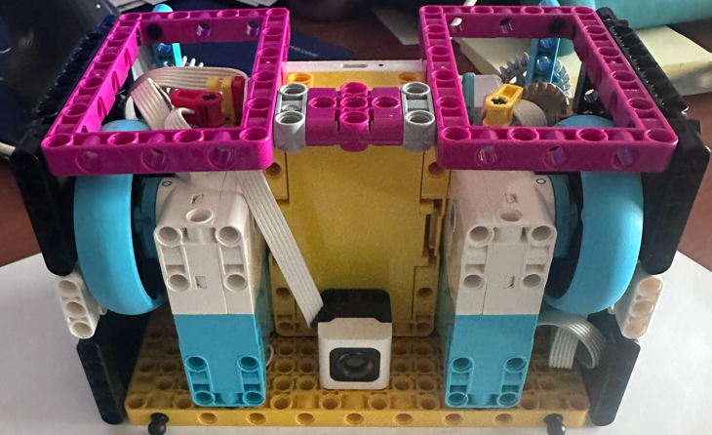
DESIGN - Iterate and learn
Third
Current
Second
First
Notes:
Saumya

Slide 11
DESIGN- Key Components and Considerations
Box design : Flat frames on all sides: lets us swap attachments quickly between runs
4 Motors
2 for Wheels
2 for attachments
More powerful motors for attachments
2 rubber wheels to reduce slips and more accuracy
1 caster wheels with steel ball
Charge port accessible
2 Color sensors
Notes:
Saumya

Slide 12
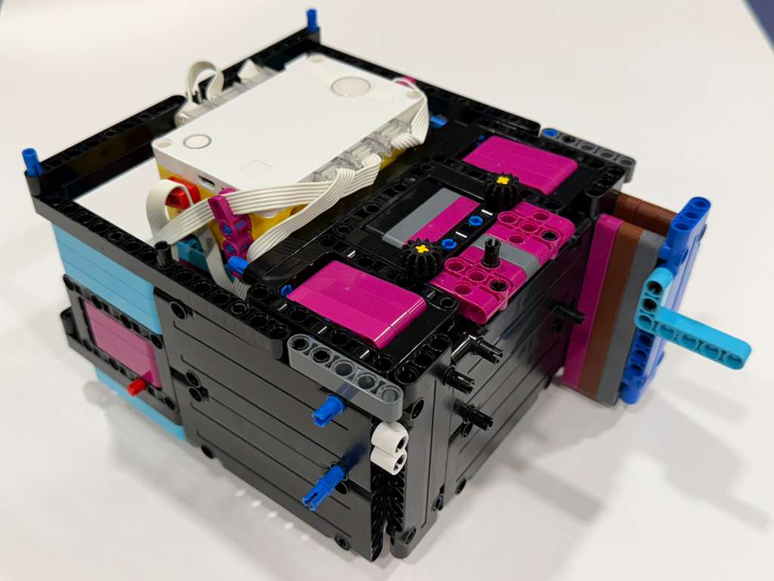
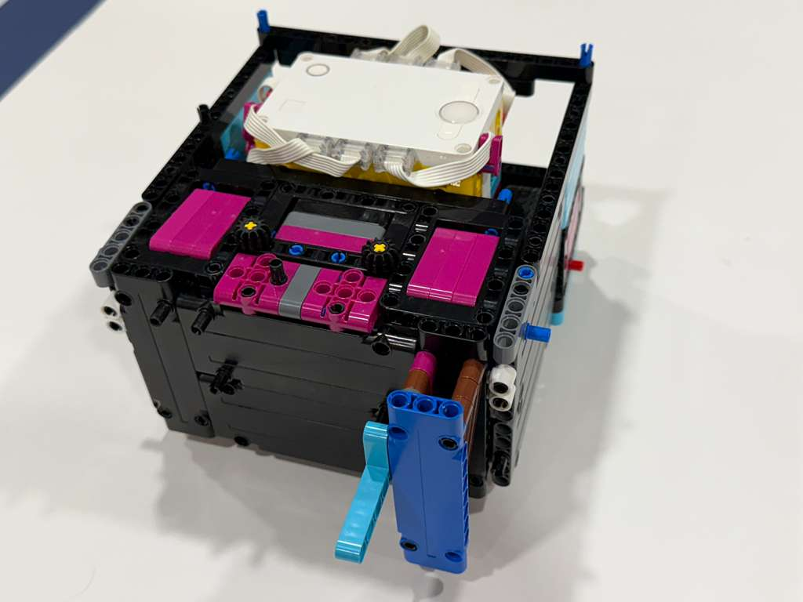
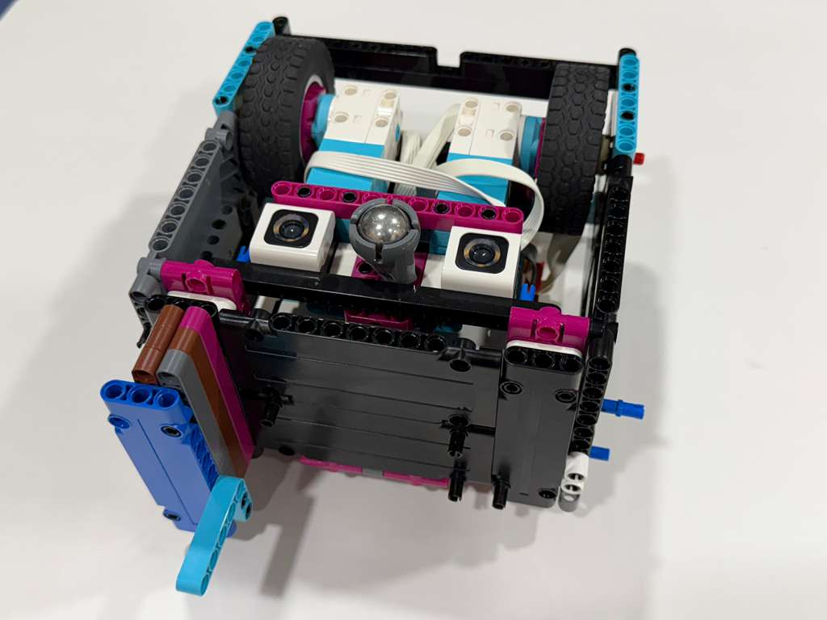
Selected Design of Robot
Notes:
Girisha

Slide 13
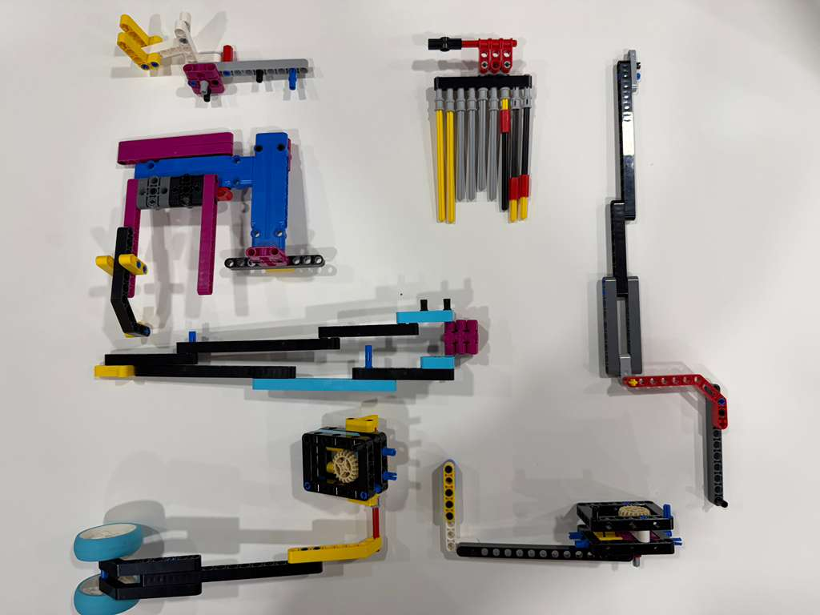
CREATE - Attachments Developed
It’s easy to add attachments on left and right side of front of robot.
We also made several simple attachments for missions
Notes:
Riya

Slide 14
CREATE - Sample Reusable Routines(Myblocks) developed
Move Straight Accurately
Move Left
Move Right
Move Reverse
Move Right Arm
Move Left Arm
Notes:
Riya

Slide 15
Share and Enjoy
We took turns and shared workload and experience.
Team had 7 girls and we became good friends and had lot of fun during break time.
We got better at programming and learned to use Gyro for more accurate movements.
At times robot did not work as programmed and broke models and seeing it fail was funny.
We had so much fun during field trip at Nelson Leges Quarry park.
We discovered new and creative ways to solve missions and really enjoyed it.
Notes:
Zoey

Slide 16
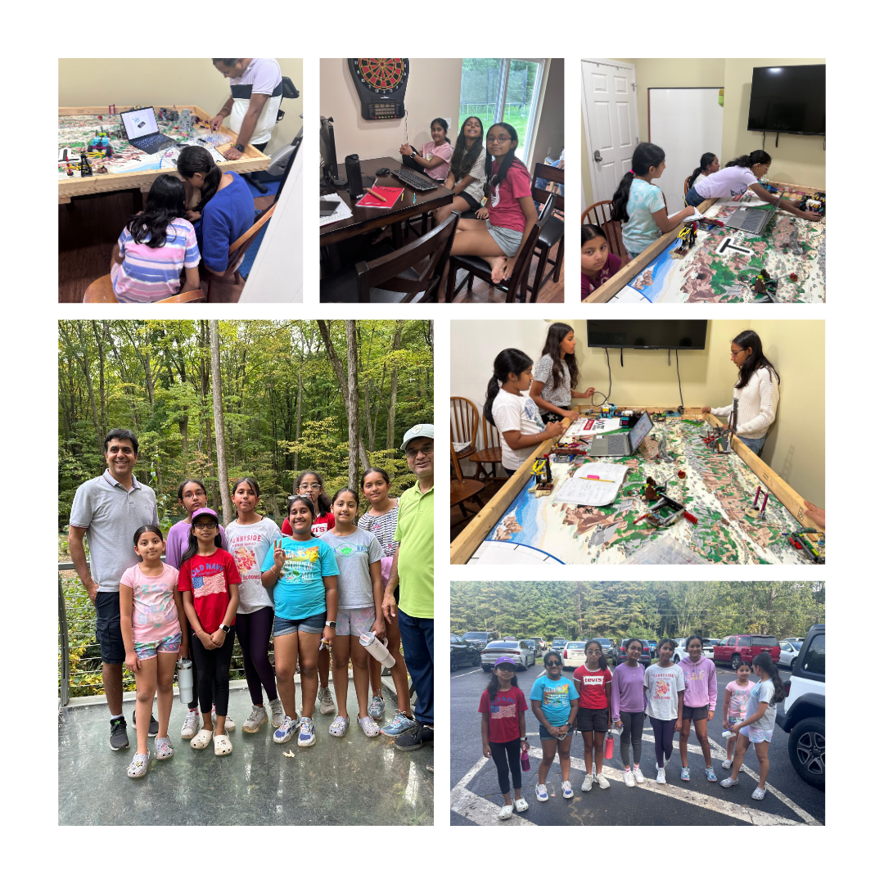
Notes:
Saumya
Here are some pictures we captured during our season with some fun moments

